Slide 1
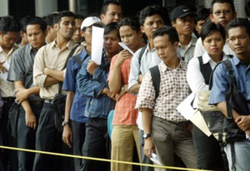
Unemployment and Potential labour force: Measurement & dissemination issues
Wachyu Winarsih, M.Si
Head of Sub Directorate of Labor Force Statistics
Directorate of Population and Labor Force Statistics
BPS - Statistics Indonesia

Slide 2
BPS - Statistics Indonesia
Contents
Unemployment
Potential labour force
Measurement in labour force surveys
Measures of labour underutilization and related dissemination issues

Slide 3
BPS - Statistics Indonesia
Recall: Labour underutilization: Scope
“Refers to mismatches
between labour supply and demand,
which translate into an unmet need for employment among the population”
Para 40,Resol I. (19th ICLS, 2013)
In reference to employment (work for pay or profit)
Identifies groups among the employed & persons outside the labour force who share similarities with the unemployed
Focuses on issues of insufficient labour absorption
For broader labour market monitoring

Slide 4
BPS - Statistics Indonesia
Labour underutilization: 3 main components
Working age population
Labour force
Outside the labour force
Labour market attachment
Employed
(for pay/profit)
Unemployed
Time-related underemployed
Potential
Labour Force
-seeking, not available
-available, not seeking
Want employment
but not seeking,
not available
Do not want employment
Labour underutilization
(unmet need for employment)

Slide 5
BPS - Statistics Indonesia
Labour force status classification Activity principle + priority rule + 1 hr. criterion
Working age population (a + b + c)
In short reference period,
worked for pay / profit for 1+ hours
NOT EMPLOYED
(without work for pay/ profit)
Y
N
With job for pay / profit, not at work
Seeking work for pay/profit
1st
N
Y
2nd
N
Y
Available
Y
N
a. Employed
3rd
b. Unemployed
Labour force (a + b)
c. Outside the labour force
ILO Department of Statistics
5
5

Slide 6
BPS - Statistics Indonesia
Unemployment
Definition Reference periods Methods of job search Special cases

Slide 7
BPS - Statistics Indonesia
Unemployment: Scope
Indicator of current unused supply of labour
Different from beneficiaries of unemployment insurance
Emphasis on monitoring labour markets
Captures persons without employment, putting pressure on labour market
Signals situations of potential match between available labour supply (people) and available demand (jobs)
May be engaged in other activities, or receive government benefits
Unemployed housewife, unemployed student, unemployed subsistence farmer, unemployed pensioner
Measured only through household surveys
Need to establish person’s job search and availability

Slide 8
BPS - Statistics Indonesia
Unemployed persons : Operational definition
Working age persons who were:
Not employed in
last 7 days / reference week
Carried out activities to seek employment in
last 4 weeks / reference month
Available to start job/business
In reference week OR
In short subsequent period (up to 2 weeks)
Highlights potential matches between available labour supply (people) and available demand (jobs) at a given point in time
Must fulfil ALL three criteria to be classified as unemployed

Slide 9
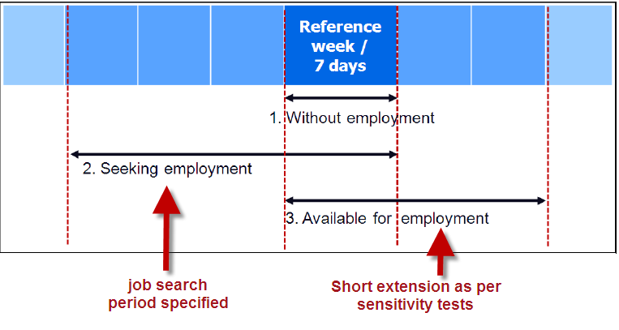
BPS - Statistics Indonesia
Unemployment: Reference periods
To capture unemployment among different groups usually engaged in other activities (women, rural areas)

Slide 10
BPS - Statistics Indonesia
Availability reference period: Optional extension
As per sensitivity tests
To reduce differences across groups due to social/contextual factors
Unemployment rate under different reference periods for “availability”, Madagascar 2010.
 | In ref. week | One week after | One month after
Men | 6,0 % | 6,6 % | 6,6 %
Women | 5,8 % | 7,0 % | 7,0 %
Total | 5,9 % | 6,8 % | 6,8 %
Previous standards
Rise
No change after month

Slide 11
BPS - Statistics Indonesia
Job search activities
Must create an opportunity for a job match
Examples of active search methods (when to find a job opportunity):
Arranging for financial resources, applying for permits
Looking for land, premises, machinery, supplies, …
Seeking assistance from friends, family, other intermediaries
Registering with or contacting public or private employment services
Applying to employers directly, checking at worksites, farms, factory gates, markets, etc
Placing / applying to newspaper or online job ads
Placing / updating resumes on professional sites online

Slide 12
BPS - Statistics Indonesia
Special cases: Unemployed or Not?
Persons with job offer to start in the future
Unemployed only if they are currently available to work
Persons on indefinite layoff
Not unemployed, they must seek work and be available
Persons waiting results of a job application
Not unemployed, they must seek work and be available
Persons reading the job advertisement section of newspaper
Not unemployed, they must apply to a job and be available

Slide 13
BPS - Statistics Indonesia
Potential labour force
Operational definition Components Discouraged job seekers

Slide 14
BPS - Statistics Indonesia
Potential labour force
Sub-group of persons outside the labour force
With expressed interest in employment
Relevant in contexts with
Limited labour market, job opportunities
Limited channels to seek employment
Relevant for groups
With other responsibilities (women, students)
Environment limits their capacity to seek / be available for work

Slide 15
BPS - Statistics Indonesia
Persons outside the labour force 3 alternative classifications
By labour market attachment
Do they express interest in employment?
By main reason for not being in the labour market
Why are they not engaged in the labour market?
By main activity
What is their main situation?
Essential to identify potential labour force

Slide 16
BPS - Statistics Indonesia
Population outside labour force by labour market attachment
Seeking employment, but not available
Not seeking employment, but want and available to work
Discouraged
Not seeking, Not available but want employment
Does not want employment
Labour market attachment
Based on SAME questions used to identify the unemployed

Slide 17
BPS - Statistics Indonesia
Classification of POLF by labour market attachment
Working age population
Labour force
Outside the labour force
Employed
(for pay/profit)
Unemployed
-seeking, not available
-not seeking but
want and available
not seeking,
not available but
Want employment
Do not want employment

Slide 18
BPS - Statistics Indonesia
Potential labour force
Seeking employment, but not available
Not seeking employment, but want and available to work
Discouraged
Not seeking, Not available but want employment
Does not want employment
Unavailable
job seekers
Available
non-job seekers
Comprises two sub-groups of persons outside the labour force
Unavailable job seekers
Available, but not seeking employment
ILO Department of Statistics
18

Slide 19
BPS - Statistics Indonesia
Discouraged job seekers
Sub-group of potential labour force
Identified by cross-classification of population outside labour force by
Labour market attachment
Reasons for not being in labour market
Definition
Working age persons, not in employment, who were
Not seeking employment due to labour market reasons
But available and wanting employment

Slide 20
BPS - Statistics Indonesia
Classification by Main reason for not being in labour market
Personal reasons
Own illness, disability
Studies, training
Family related reasons
Pregnancy, family or household responsibilities
Refusal by family
Labour market reasons
Past failure in finding a job, gave up looking for jobs
Lack of experience, qualifications or jobs matching skills
Lack of jobs in the area
Considered too young or too old by prospective employers
Lack of infrastructure
No roads, transport, employment services in the area
Other sources of income
Pensions, rents
Serves to identify discouraged job seekers

Slide 21
BPS - Statistics Indonesia
Measurement in
labour force surveys
Basic survey structure Essential question flow Question formulation

Slide 22
BPS - Statistics Indonesia
Identification in labour force surveys
0+
Module I: Household Roster & Demographic Characteristics
n+
Module II: Education & training
WAP
Module III: Participation in the Labour Market
Identification of persons in employment
Y
1st
N
Persons in employment
Persons NOT in employment
-Characteristics of main job
-Characteristics of other jobs
2nd
-Job search & availability
-Previous employment experience
3rd
Module IV: Participation in Own use production of goods
Optional Work modules:
Unpaid trainee work
Volunteer work
Provision of services for own final use

Slide 23
BPS - Statistics Indonesia
Implementation issues
Emphasis on active job search
Sequence should start with question on job search
Methods of job search serve as test of active search
Questions should be appropriate for all types of jobs
Search for self-employment jobs and paid employment, part-time work, paid apprentice type work, etc.
Requires new question on desire to work for pay or profit
Asked only to persons who did not carry out job search activities
Availability serves to determine readiness in terms of time
Should be asked to all persons who seek or want to work for pay or profit
Question should clarify this (i.e. how soon can person start working)
Includes availability to work part-time or full-time

Slide 24
WORKING AGE POPULATION
BPS - Statistics Indonesia
Worked for pay / profit
for 1+ hours
NOT EMPLOYED
(without work for pay/ profit)
Y
N
With job, not at work
N
Seeking work for pay/profit
Y
Reason of absence
Y
N
Job search method
Want work
Duration
Duration of search
Y
N
≤3 mo.
>3 mo.
Char. Job sought
Reason not seeking
Pay
N
Y
Available
Available
Y
N
Y
N
Reason / Situation
E
U
Potential LF
Willing
Others
Labour force
Outside labour force
ILO Department of Statistics
24

Slide 25
BPS - Statistics Indonesia
Identification in labour force surveys
Employed in last week?
No
Unemployed
Looked for work in last 4 weeks?
YES
YES
No
Is currently available to work?
Wants work for pay / profit
YES
No
Is currently available to work?
Potential labour force
YES
ILO Department of Statistics
25

Slide 26
BPS - Statistics Indonesia
Sample questions (I): Active job search

Slide 27
BPS - Statistics Indonesia
Sample questions (II): Duration of job search
Comprises the period from when the person last stop working or when started seeking work up to the interview date, whichever is the shortest
For future starters, it ends when the person got the job/business opportunity
Serves to identify persons in long-term unemployment, defined as:
“Unemployed persons who have been without work and seeking work for 12 months or more”
ILO Department of Statistics
27

Slide 28
BPS - Statistics Indonesia
Sample questions (III) Desire, Reasons & Availability

Slide 29
BPS - Statistics Indonesia
Measures of labour underutilization and related dissemination issues
Tabulations
Classifications for analysis
Reporting documentation
International reporting

Slide 30
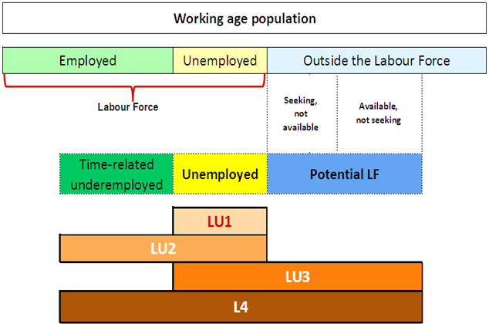
BPS - Statistics Indonesia
NEW Measures of labour underutilization (LU1-LU4)
LU4
30

Slide 31
BPS - Statistics Indonesia
Four indicators: to assess the nature of LU throughout the business cycle:
LU1: Unemployment rate:
[persons in unemployment / labour force] x 100
LU2: Combined rate of time-related underemployment and unemployment:
[(persons in time-related underemployment + persons in unemployment) / labour force] x 100
LU3: Combined rate of unemployment and potential labour force: 3
[(persons in unemployment + potential labour force) / (extended labour force)] x 100
LU4: Composite measure of labour underutilization:
[(persons in time-related underemployment + persons in unemployment + potential labour force) / (extended labour force)] x 100
Indicators of labour underutilization
Note: extended LF =
LF + potential labour force

Slide 32
BPS - Statistics Indonesia
Tabulations
Statistics should be tabulated by sex, specified age groups, level of educational attainment and by region, including urban and rural areas.
For descriptive analysis of the labour market, tabulations should be produced on:
(a) working-age population by labour force status (including unemployment) and category of labour underutilization; and transitions (gross flows) between statuses, where possible;
(b) persons in unemployment or outside the labour force by characteristics of their current or last main job, e.g. industry, occupation, status in employment, type of economic unit (formal market units/informal market units/non-market units/households), institutional sector, geographic location of place of work, type of remuneration, specified bands of employment-related income and specified working- time hour bands, according to the relevant international statistical standards;
(c) persons in unemployment by duration intervals of search for employment that permit separate identification of persons in long-term unemployment.

Slide 33
BPS - Statistics Indonesia
Classifications for analysis of POLF (1)
Classifications may be used to study subgroups of persons outside the labour force, e.g. those affected by discouragement or by gender-based, economic or social barriers to employment:
Degree of labour market attachment :
(i) persons “seeking employment” but not “currently available”
(ii) persons not “seeking employment” but “currently available”
(iii) persons neither “seeking employment” nor “currently available” but who want employment
(iv) persons neither “seeking employment” nor “currently available” who do not want employment

Slide 34
BPS - Statistics Indonesia
Classifications for analysis of POLF (2)
Main reason for not “seeking employment”, not being “currently available” or not wanting employment:
personal reasons (own illness, disability, studies)
family-related reasons (pregnancy, presence of small children, refusal by family)
labour market reasons (past failure to find a suitable job, lack of experience, qualifications or jobs matching the person’s skills, lack of jobs in the area, considered too young or too old by prospective employers)
lack of infrastructure (assets, roads, transportation, employment services)
other sources of income (pensions, rents)
social exclusion

Slide 35
BPS - Statistics Indonesia
Reporting documentation
To enhance transparency, statistics should be reported with regard to:
scope and coverage
concepts and definitions
any estimation or adjustment methods, including seasonal adjustments or imputation procedures
where possible, measures of data quality and precision, e.g., relative standard errors that account for complex survey designs
Revisions, new time series or indicators should be adequately indicated and documented, e.g. publication of dual estimates or series, for at least one year, following their implementation.

Slide 36
BPS - Statistics Indonesia
International reporting – Labour underutilization
Countries are encouraged to report headline indicators of labour underutilization (from among LU1, LU2, LU3 and LU4)
for the population as a whole
by sex
by urban/rural areas
by levels of educational attainment
by standard age ranges

Slide 37
BPS - Statistics Indonesia
References:

Slide 38
Thank you

