Slide 1

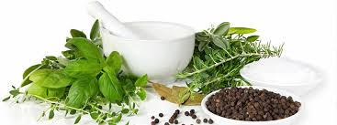
Republic of Turkey Ministry of Health
General Directorate of Health Services
Department of Traditional and Complementary Medicine
2018

Slide 2
Republic of Turkey Ministry of Health
General Directorate of Health Services
Workshop on the Integration of Traditional and Complementary Medicine to the Health Systems and Health Services (April 18, 2018)
Organization of Islamic Cooperation (OIC) Health Strategy Action Programme (2014-2023) contains 6 thematic areas of cooperation to be realized among the member countries.
Thematic areas include the mechanism of the “Leader Coordinator Countries Group” was established to ensure cooperation and coordination among member states.
For the thematic area, "Strengthening Health Systems“, Turkey is the Leader Coordinator Country.
According to the Action Program, health system strengthening is one of the areas of priority cooperation among OIC Member States, which provides opportunity for the development of the OIC's organizational cooperation capacity.
Notes:
ATÖLYELERİN GELENEKSEL VE TAMAMLAYICI TIPTAN SAĞLIK SİSTEMLERİ VE SAĞLIK HİZMETLERİNE ENTEGRASYONU
İslam İşbirliği Teşkilatı Sağlık Stratejileri Hareket Programı üye ülkelerin gerçekleştirmesi gereken 6 tematik alan içermektedir.
Üye ülkeler arasında işbirliği ve koordinasyon sağlanması için lider koordinatör ülkeler grubu kurulmuştur.
Türkiye Sağlık Sistemlerinin güçlendirilmesi tematik alanının lider koordinatör ülkesidir.
Eylem planına göre, sağlık sisteminin güçlendirilmesi tematik alanı İslam İşbirliği Teşkilatının kurumsal işbirliği kapasitesinin geliştirilmesinde üye ülkeler arasında öncelikli işbirliği alanlarındandır.

Slide 3
Republic of Turkey Ministry of Health
General Directorate of Health Services
Workshop on the Integration of Traditional and Complementary Medicine to the Health Systems and Health Services (April 18, 2018)
The objective of "Strengthening Access to Integrated, Secure and Quality Health Services" under the Thematic Area-1 has been identified as an important area of cooperation between the OIC member countries. Among the subheadings included in this target are;
Facilitate sharing of knowledge and examples of successful implementation in the direction of capacity building programs
Facilitating cooperation in the field of specialization in the areas of benefiting from integrated and high quality health services (including medical, pharmaceutical and nursing services) is included in the scope of cooperation
Notes:
ATÖLYELERİN GELENEKSEL VE TAMAMLAYICI TIPTAN SAĞLIK SİSTEMLERİ VE SAĞLIK HİZMETLERİNE ENTEGRASYONU
Tematik Alan-1’in altında yer alan “Entegre, Güvenli ve Kaliteli Sağlık Hizmetlerine Erişimin Güçlendirilmesi” Hedefi, İİT üye ülkeleri arasında önemli bir işbirliği alanı olarak belirlenmiştir. Bu hedefin kapsamında yer alan alt başlıklar arasında ise;
Kapasite inşa programları doğrultusunda bilgi ve başarılı uygulama örneklerine ilişkin tecrübe paylaşımının kolaylaştırılması
Entegre ve kaliteli sağlık hizmetlerinden yararlanmada (tıbbi, farmasötik ve bakım hizmetlerini de içerecek şekilde) uzmanlık branşlarında İİT nezdindeki işbirliğinin kolaylaştırılması konuları yer almaktadır.

Slide 4
Republic of Turkey Ministry of Health
General Directorate of Health Services
Current Situation of Traditional and Complementary Medicine in Turkey
Today, the provision of health services is based on classical methodologies as well as traditional and complementary medicine approaches.
Traditional and complementary medical practices have evolved from being an exceptional approach to a globally recognized concept.
In order to systematize the actual situation, various international organizations, especially the World Health Organization, publish reference documents related to the subject.
Aims of «World Health Organization 2014-2023 Traditional Medical Strategy plan»:
  Integration of traditional and complementary medical practices in national health policies.
  Evidence-based information and knowledge production.
  Improvement of health service provision, especially preventive health services.
  To ensure that the applications are carried out following standards.
  To regulate the practitioners and to monitor and evaluate Traditional and Complementary Medical Practices.
Notes:
GELENEKSEL VE TAMAMLAYICI TIBBIN TÜRKİYE’DEKİ GÜNCEL DURUMU
Günümüzde iyilik halinin devamını sağlamada sağlık hizmetlerinin sunumu, klasik metodolojilerin yanı sıra geleneksel ve tamamlayıcı tıp yaklaşımlarını da içermektedir.
Geleneksel ve tamamlayıcı tıp uygulamaları istisnai bir yaklaşım olmaktan çıkarak, küresel çapta kabul gören bir konsepte kavuşmaya başlamıştır.
Oluşan fiili durumu sistematize etmek amacıyla başta Dünya Sağlık Örgütü olmak üzere çeşitli uluslararası örgütler, konuya ilişkin referans dokümanlar ortaya koymaktadır.
DSÖ’NÜN 2014-2023 GELENEKSEL TIP STRATEJİ PLANI HEDEFLERİ
Geleneksel ve Tamamlayıcı Tıp Uygulamalarının ulusal sağlık politikalarına entegrasyonu
Kanıta dayalı bilgi ve değer üretimi
Sağlık Hizmetleri sunumunun iyileştirilmesi, özellikle koruyucu sağlık hizmetleri.
Uygulamaların standartlara uygun olarak yürütüldüğünün güvence altına alınması.
Hekimlerin durumunun regule edilmesi ve Geleneksel ve Tamamlayıcı Tıp Uygulamalarının izlenilmesi ve değerlendirilmesi.

Slide 5
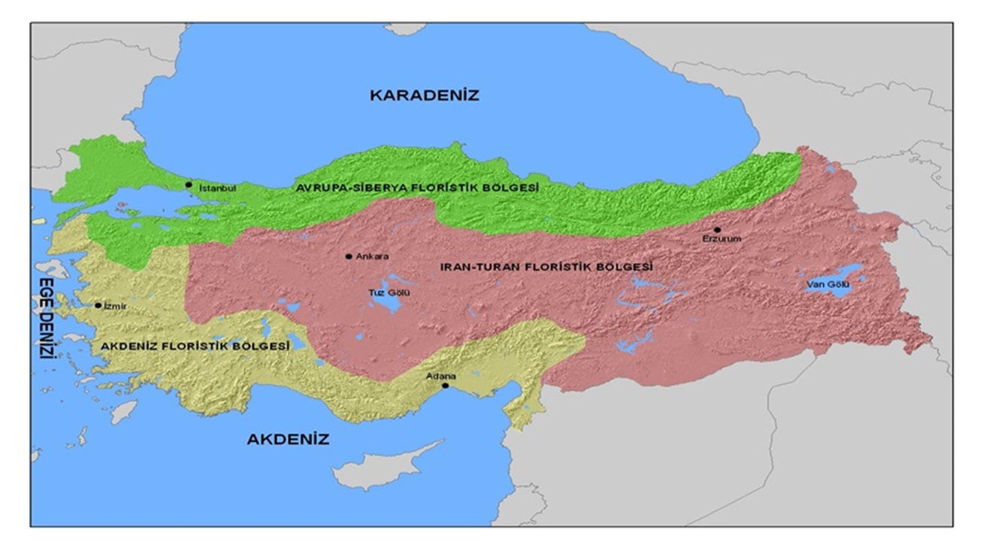
Republic of Turkey Ministry of Health
General Directorate of Health Services

Slide 6
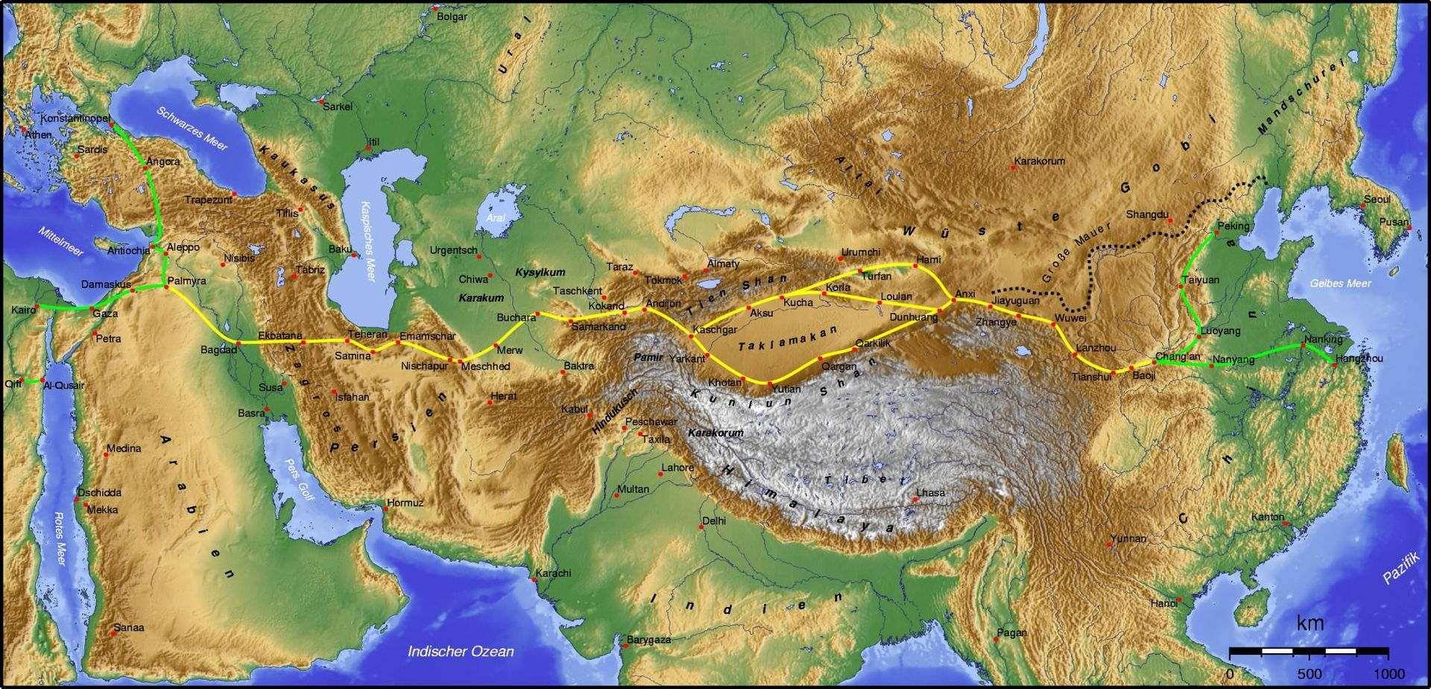
Republic of Turkey Ministry of Health
General Directorate of Health Services

Slide 7
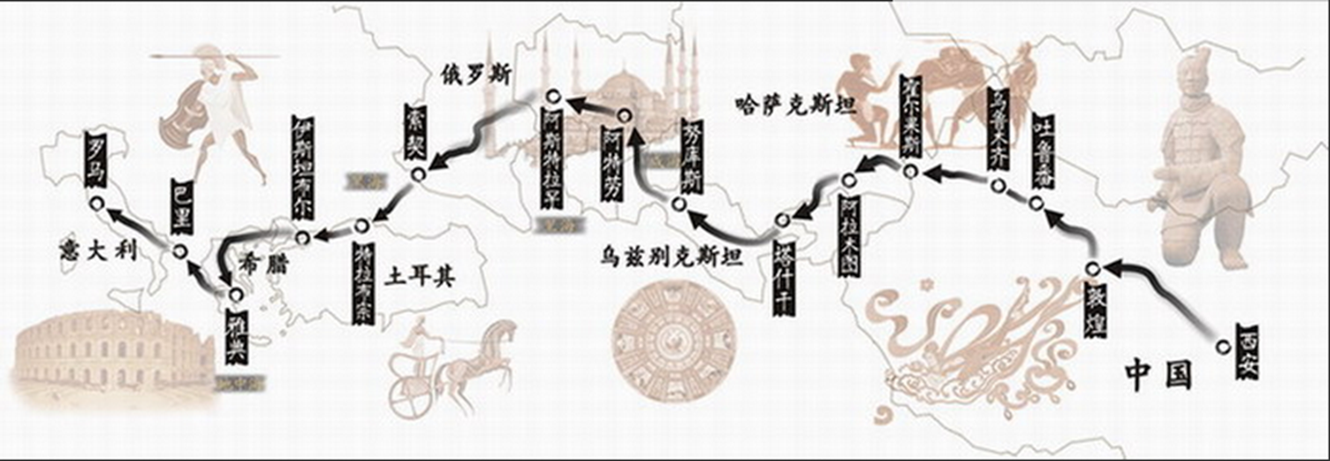
Republic of Turkey Ministry of Health
General Directorate of Health Services

Slide 8
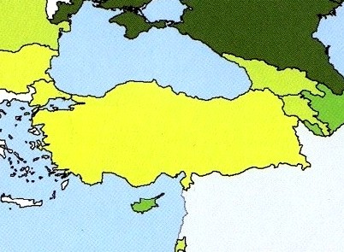
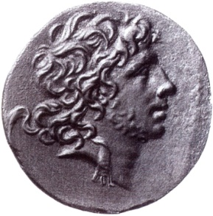
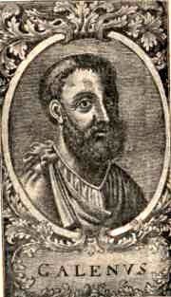
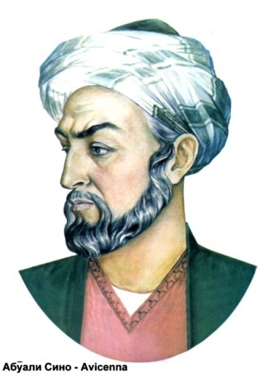
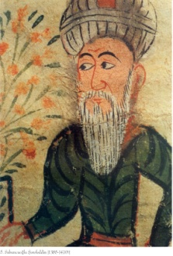
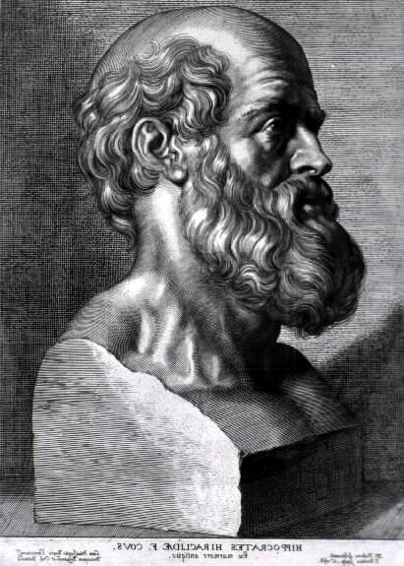
Ebu Reyna Biruni (973-1051)
Türkmenistan
Kitab al saydada
Eupator Mithridates
(İ.Ö:132-63)
İbn Sina (970-1037)
Türk Hekimi
Kanun fit tıb 800 drog
Galen (130-201)
Bergama/İZMİR
Hekimlerin İmparatoru
Sabuncuoğlu
Şerafeddin
1385-1470
İshak bin Murad (1389)
Edviyei Müfrede
Merkez Efendi
1539 Manisa
İbn El Baytar (1197-1248)
Baytarname-1400 drog
HIPPOCRATES
(İ.Ö:460-377)
İstanköy-Cos Adası/Bodrum
Discorides (20-79)
Materia Medica
Adana-Ceyhan
Dinaveri (820-895) Kitab an nabat
Muhittin Arabi
Teophraste (İ.Ö:370-287)
Midilli-Botaniğin Babası
Fahrettin İrazi

Slide 9

Cambrella Project
CAMbrella was a research network that work on traditional and alternative medicine practices in European Union Countries
Project Duration: January 2010- November 2012
There are 16 different research institutes in 12 European Countries
Project Coordination: Competence Centre for Complementary Medicine and Naturopathy (CoCoNat), Klinikum rechts der Isar, Tech. Univ. Munich, Germany
Total 8 Work package
Project Budget: 1.498.597 Euro

Slide 10
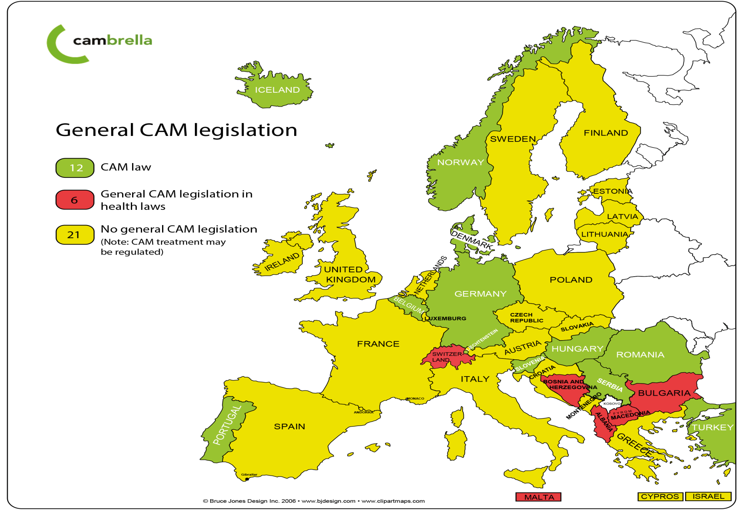
Complementary and Alternative Medicine Legislation Map in EU

Slide 11

World Health Organization
The WHO Traditional Medicine Strategy 2014–2023 was developed and launched in response to the World Health Assembly resolution on traditional medicine (WHA62.13). The strategy aims to support Member States in developing proactive policies and implementing action plans that will strengthen the role traditional medicine plays in keeping populations healthy.
Addressing the challenges, responding to the needs identified by Member States and building on the work done under the WHO traditional medicine strategy (2002–2005), the updated strategy for the period 2014–2023 devotes more attention than its predecessor to prioritizing health services and systems, including traditional and complementary medicine products, practices and practitioners.

Slide 12
Republic of Turkey Ministry of Health
General Directorate of Health Services
Organization Chart
Traditional and Complementary Scientific Board
Scientific Accreditation Board
General Manager
Prof. Alper CİHAN, M.D.
Deputy General Manager
Mehmet GÜNDÜZ,M.D.
Head of Department
Mehmet Zafer KALAYCI, M.D.
Licensing Unit
Training and Certification Unit
Legislation and Control Unit

Slide 13
Republic of Turkey Ministry of Health
General Directorate of Health Services
Our Mission
Regulatory work related to traditional and complementary medicine(T&CM) practices in our country.
Licensing, inspection, control, training and certification.
Ensuring the regulation of clinical research.
Developing the area of T&CM in our country by national and international collaborations.
Notes:
MİSYONUMUZ
Ülkemizde Geleneksel ve Tamamlayıcı Tıp Uygulamalarla ilgili mevzuat çalışmaları yaparak; geleneksel ve tamamlayıcı tıp sahasının ruhsatlandırma, denetim, eğitim ve sertifikasyon, klinik araştırma konularının regülasyonunu sağlamak, Ulusal ve uluslararası işbirlikleri ile ülkemiz geleneksel ve tamamlayıcı tıp uygulamalarını geliştirmektir

Slide 14
Republic of Turkey Ministry of Health
General Directorate of Health Services
Our Vision
Our aim is to provide the integration of traditional and complementary medicine to modern medical practices, in order to improve the quality of life of society.
To contribute to the health economy through health investments and health tourism in our country
To contribute to promote, develop and standardize evidence-based traditional and complementary medicine practices by studies conducted with the support of European Union and World Health Organization in our country.
Notes:
VİZYONUMUZ
Toplumun yaşam kalitesini arttırmak amacıyla geleneksel ve tamamlayıcı tıp uygulamalarının modern tıp uygulamalarına entegrasyonu sağlamak, ülkemiz sağlık yatırımlarına, sağlık turizmine ve sağlık ekonomisine katkı sağlamak, Dünya Sağlık Örgütü, Avrupa Birliği ile çalışmalar yürüterek ülkemizde kanıta dayalı geleneksel ve tamamlayıcı tıp uygulamalarını yaygınlaştırması, tanınması ve geliştirilmesine imkan tanımak

Slide 15
4
Republic of Turkey Ministry of Health
General Directorate of Health Services
Legal Infrastructure of Traditional and Complementary Medicine
«Regulation On Traditional And Complementary Medicine Practices» was published in the Official Gazette dated 27.10.2014 with the issue number 29158.
Regulation contains 6 main parts and appendices:
Part 1: Objective, Scope, Basis, and Definitions
Part 2: Scientific Committee, Its Duties and Working Principles
Part 3: Principles of Practice, Types of Healthcare Institutions and Their Working Principles, Training
Part 4: Minimum Departments, Medical Equipments that are mandatory to stock in Application Centers
Part 5: Audit, Other Requirements, Prohibitions, and Administrative Sanctions
Notes:
Kısım: Hedef, Kapsam, Temel ve Tanımlar
Bilimsel Komite, Görevleri ve Çalışma Prensipleri
Uygulama Prensipleri, Enstitü ve Uygulama merkezi, eğitim
Fiziki alan
Denetim, İdari İşlemler(yaptırımlar)

Slide 16
4
Republic of Turkey Ministry of Health
General Directorate of Health Services
Legal Infrastructure on Traditional and Complementary Medicine
Appendix-1: Documents Required for the Application of License to Open a Unit and Practice Centre
Appendix-2: Minimum Equipment for Units and Centres
Minimum Drugs for Units and Centres
Appendix-3: List of Practices Permitted in Units and Practice Centres
1 -Acupuncture Practice 8- Mesotherapy Practice
2- Hypnosis Practice 9- Osteopathy Practice
3- Hirudotherapy Practice 10- Chiropractic Practice
4- Reflexology Practice 11- Maggot Therapy Practice
5- Ozone Therapy Practice 12- Apitherapy Practice
6- Homeopathy Practice 13- Prolotherapy Practice
7- Phytotheraphy Practice 14- Cupping Therapy Practice
15- Music Therapy Practice

Slide 17
Republic of Turkey Ministry of Health
General Directorate of Health Services
Reimbursement Status
T&CM therapy treatment or medical products are not covered by either public or private insurance in Turkey.
Practice Centers
Practice centers; indicates the centre established under the responsibility of a physician and/or a dentist (limited with their professions) having a corresponding certificate, located in research hospital or a faculty of medicine or a faculty of dentistry in order to perform the practices specified in the Regulation, that can provide training upon the authorization by the Ministry.
ARTICLE 13 – (1) The certified trainings within the scope of this Regulation shall be provided by the centers which are authorized by the Ministry to provide training under the Regulation on Certified Training of the Ministry of Health which has been published in the Official Gazette dated February 4, 2014 and numbered 28903.
Notes:
GERİ ÖDEME DURUMLARI
UYGULAMA MERKEZLERİ (çlışanlar)
Uygulayıcılar(tabip, diş tabibi): kısımlar açıklanacak.
Ek 13. Atıfta bulun.

Slide 18
Republic of Turkey Ministry of Health
General Directorate of Health Services
Practice Centers
1 | İZMİR BOZYAKA EĞİTİM VE ARAŞTIRMA HASTANESİ
2 | ATATÜRK ÜNİVERSİTESİ (ERZURUM)
3 | BALIKESİR ÜNİVERSİTESİ
4 | BAŞKENT ÜNİVERSİTESİ
5 | FIRAT ÜNİVERSİTESİ
6 | GAZİ ÜNİVERSİTESİ
7 | YILDIRIM BEYAZIT ÜNİVERSİTESİ
8 | BAĞCILAR EĞİTİM VE ARAŞTIRMA HASTANESİ (İSTANBUL)
9 | BEZMİALEM VAKIF ÜNİVERSİTESİ (İSTANBUL)
10 | İSTANBUL MEDİPOL ÜNİVERSİTESİ (İSTANBUL)
11 | CUMHURİYET ÜNİVERSİTESİ (SİVAS)
12 | İZMİR KATİP ÇELEBİ ÜNİVERSİTESİ ATATÜRK EĞİTİM VE ARAŞTIRMA EĞİTİM VE ARAŞTIRMA HASTANESİ
13 | HACETTEPE ÜNİVERSİTESİ
14 | KAYSERİ EĞİTİM VE ARAŞTIRMA HASTANESİ
15 | EGE ÜNİVERSİTESİ
16 | ELAZIĞ EĞİTİM VE ARAŞTIRMA HASTANESİ
17 | GÜLHANE EĞİTİM VE ARAŞTIRMA HASTANESİ
18 | ÜMRANİYE EĞİTİM VE ARAŞTIRMA HASTANESİ
19 | ANTALYA EĞİTİM VE ARAŞTIRMA HASTANESİ
20 | SAKARYA ÜNİVERSİTESİ
21 | KONYA NECMETTİN ERBAKAN ÜNİVERSİTESİ
22 | ADNAN MENDERES ÜNİVERSİTESİ
23 | HARRAN ÜNİVERSİTESİ (ŞANLIURFA)
24 | YEDİTEPE ÜNİVERSİTESİ
25 | KARABÜK EĞİTİM VE ARAŞTIRMA HASTANESİ
26 | KEÇİÖREN EĞİTİM VE ARAŞTIRMA HASTANESİ
27 | ANKARA EĞİTİM VE ARAŞTIRMA HASTANES
28 | KONYA SELÇUK ÜNİVERSİTESİ
29 | ÖMER HALİSDEMİR EĞİTİM VE ARAŞTIRMA HASTANESİ (NİGDE)
30 | GAZİLER FTR EĞİTİM VE ARAŞTIRMA HASTANESİ (ANKARA)
31 | DR.ZEKAİ TAHİR BURAK KADIN SAĞLIĞI EĞİTİM VE ARAŞTIRMA HASTANESİ
32 | İNÖNÜ ÜNİVERSİTESİ
33 | AKSARAY EĞİTİM VE ARAŞTIRMA HASTANESİ
34 | ALANYA EĞİTİM VE ARAŞTIRMA HASTANESİ
35 | ŞİŞLİ EĞİTİM VE ARAŞTIRMA HASTANESİ
36 | ETLİK ZÜBEYDE HANIM KADIN HASTALIKLARI VE DOĞUM EAH. (ANKARA)
37 | İSTANBUL BİRUNİ ÜNİVERSİTESİ SAĞLIK UYGULAMA HASTANESİ

Slide 19
Republic of Turkey Ministry of Health
General Directorate of Health Services
Practice Centers
We have 18 training centers which are established in practice centers
1- Ankara Yıldırım Beyazıt University
2- Gazi University
3- Cumhuriyet University
4- Atatürk University
5- İstanbul Medipol University
6- Bezmialem University
7- Ege University
8- Bağcılar Training and Research Hospital
9- Kayseri Training and Research Hospital
10- Gülhane Training and Research Hospital
11- Ümraniye Training and Research Hospital
12- Antalya Training and Research Hospital
13- Konya Necmettin Erbakan University
14- İstanbul Yeditepe University
15- İnönü University
16- Keçiören Training and Research Hospital
17- Sakarya Training and Research Hospital
18- Aydın Adnan Menderes University

Slide 20
Republic of Turkey Ministry of Health
General Directorate of Health Services
Units
Units; indicates the units which are established under the responsibility of a physician and/or a dentist (limited with their professions) having a corresponding certificate and within a healthcare institution owned by a public and private legal person in order to perform the practices specified in this Regulation.
Notes:
BÖLÜMLER

Slide 21
Republic of Turkey Ministry of Health
General Directorate of Health Services
Number of Certificates
Practices | By Training | Equivalence Document | Total
Acupuncture | 1445 | 0 | 1445
Ozone | 836 | 22 | 858
Cupping | 1226 | 53 | 1249
Hypnosis | 101 | 23 | 124
Homeopathy | 84 | 15 | 96
Mesotherapy | 501 | 2 | 503
Apitherapy | 13 | 5 | 18
Prolotherapy | 198 | 24 | 222
Music Therapy | 0 | 11 | 11
Leech Therapy | 266 | 21 | 287
Phitotherapy-Herbal Med. | 124 | 6 | 130
Osteopathy | 0 | 5 | 5
Larvae Therapy (Maggot) | 0 | 2 | 2
Reflexology | 0 | 2 | 2
Total: 4954

Slide 22
Republic of Turkey Ministry of Health
General Directorate of Health Services
Future Goals
With the integration of traditional and complementary medical practices into the health system;
Aims:
• Prevention of existing abuses stemming from traditional and complementary medical practices,
• More effective implementation of the preventive medicine with traditional and complementary medical practices,
• For the extremely increased health expenditures it is planned to implement traditional and complementary medical applications in supportive to reinforce national health expenditures,
• From the variety of medicinal and the aromatic plants, it is intended to obtain benefits with stakeholder Ministries
Notes:
GELECEK HEDEFLERİ
Geleneksel ve Tamamlayıcı Tıp Uygulamalarının sağlık sistemine entegrasyonu ile;
Geleneksel ve Tamamlayıcı Tıp Uygulamalarından kaynaklı mevcut suistimallerin engellenmesi,
Geleneksel ve Tamamlayıcı Tıp Uygulamaları ile birlikte koruyucu hekimliğin daha efektif bir şekilde uygulanması,
Sağlık harcamalarının çok artmış olması sebebiyle Geleneksel ve Tamamlayıcı Tıp uygulamalarını mümkün olan alanlarda destekleyici amaçla devreye sokarak ülke sağlık harcamalarının dizginlenmesi,
Türkiye’deki Tıbbi Aromatik Bitki çeşitliliğinden paydaş bakanlıklarla faydalanılması

Slide 23

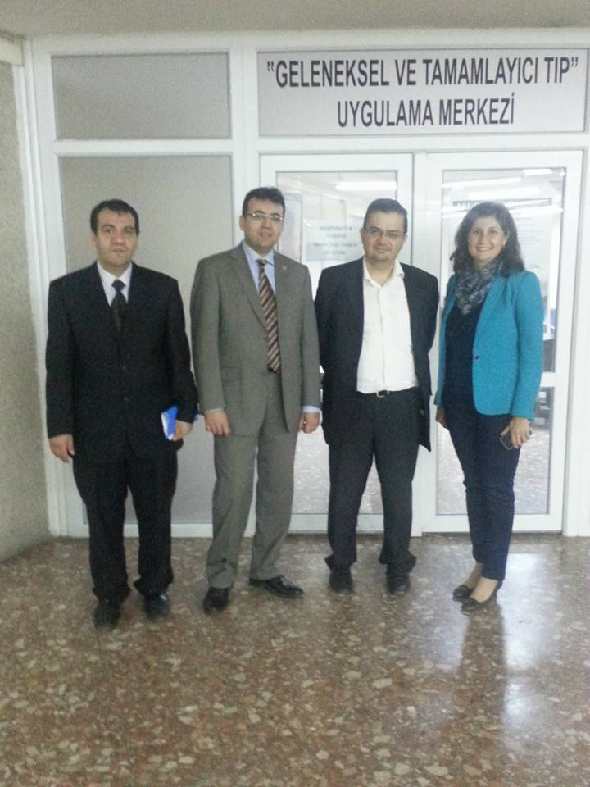
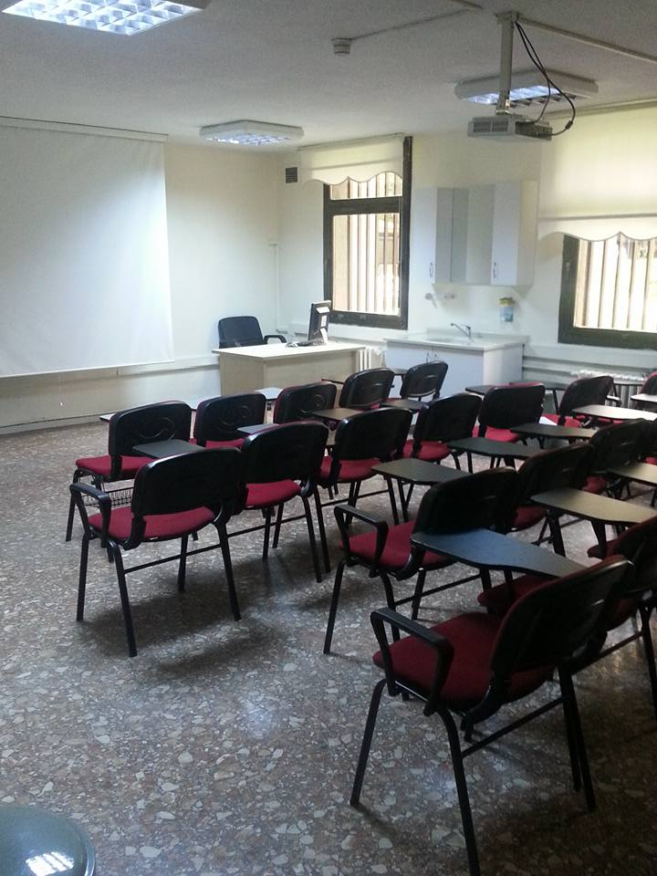
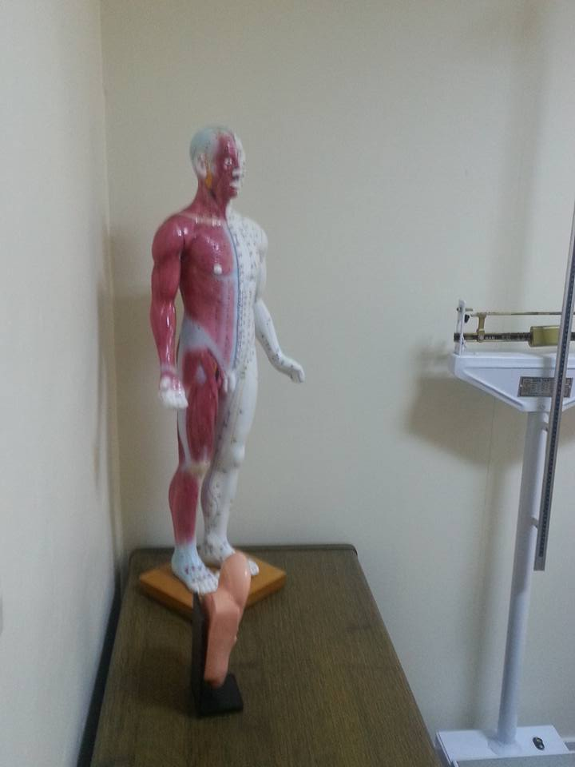
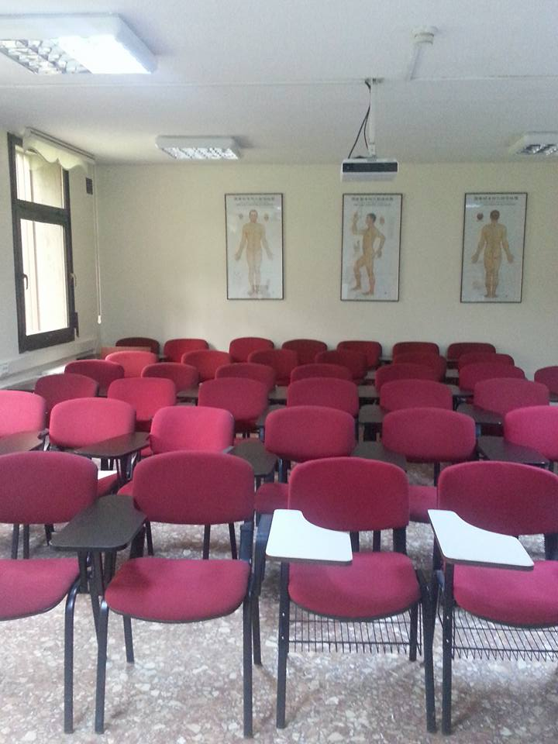
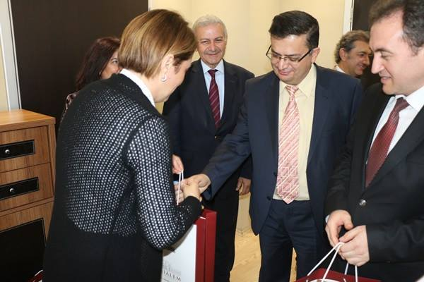
4

Slide 24
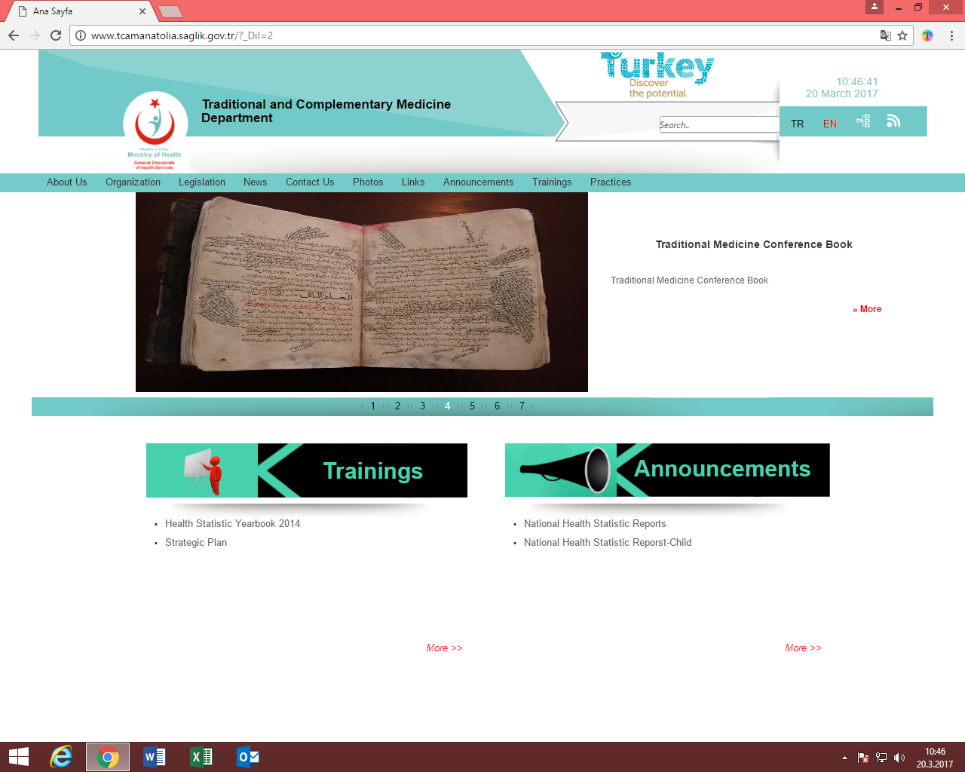
Our Web Site
www.tcamanatolia.saglik.gov.tr

Slide 25
Our Feedback System (Controlling System)

Slide 26
Republic of Turkey Ministry of Health
General Directorate for Health Services
Traditional and Complementary Medicine Department
Office Phone: +90312 471 77 77
www.tcamanatolia.saglik.gov.tr
shgm.getat@saglik.gov.tr

